Slide 1

Programming in Java
Lecture 5: Objects and Classes

Slide 2
Contents
Class
Object
Defining and adding variables
Nested Classes
Abstract Class

Slide 3
OBJECTS AND CLASS

Slide 4
Class
A class is a collection of fields (data) and methods (procedure or function) that operate on that data.
Circle
centre
radius
circumference()
area()

Slide 5
What is a class?
A class can be defined as a template/ blue print that describe the behaviors/states that object of its type support.
A class is the blueprint from which individual objects are created.
A class defines a new data type which can be used to create objects of that type. Thus, a class is a template for an object, and an object is an instance of a class.

Slide 6




Classes and Objects
A Java program consists of one or more classes.
A class is an abstract description of objects.
Here is an example class:
  class Dog { ...description of a dog goes here... }
  Here are some objects of that class:

Slide 7



More Objects
Here is another example of a class:
  class Window { ... }
Here are some examples of Windows:

Slide 8
The data, or variables, defined within a class are called instance variables because each instance of the class (that is, each object of the class) contains its own copy of these variables.
The code is contained within methods.
The methods and variables defined within a class are called members of the class.

Slide 9
Defining Classes
The basic syntax for a class definition:
Bare bone class – no fields, no methods
  class ClassName
  {
    [fields declaration]
    [methods declaration]
}
public class Circle {
// my circle class
}

Slide 10
Adding Fields: Class Circle with fields
Add fields
The fields (data) are also called the instance variables.
public class Circle {
public double x, y; // centre coordinate
public double r; // radius of the circle
}

Slide 11
Circle Class
aCircle, bCircle simply refers to a Circle object, It is not an object itself.
aCircle
bCircle
null
null
Points to nothing (Null Reference)
Points to nothing (Null Reference)

Slide 12
Creating objects of a class
An object is an instance of the class which has well-defined attributes and behaviors.
Objects are created dynamically using the new keyword.
aCircle and bCircle refer to Circle objects.
aCircle = new Circle();
bCircle = new Circle();

Slide 13
Creating objects of a class
aCircle = new Circle();
bCircle = new Circle() ;
bCircle = aCircle;

Slide 14
Creating objects of a class
aCircle = new Circle();
bCircle = new Circle() ;
bCircle = aCircle;
Before Assignment
After Assignment
aCircle
bCircle
aCircle
bCircle
P
Q
P
Q

Slide 15
Adding Methods
A class with only data fields has no life. Objects created by such a class cannot respond to any messages.
Methods are declared inside the body of the class but immediately after the declaration of data fields.
The general form of a method declaration is:
type MethodName (parameter-list)
{
Method-body;
}

Slide 16
Adding Methods to Class Circle
public class Circle {
public double x, y; // centre of the circle
public double r; // radius of circle
//Methods to return circumference and area
public double circumference() {
return 2*3.14*r;
}
public double area() {
return 3.14 * r * r;
}
}
Method Body

Slide 17
Automatic garbage collection
Q
The object does not have a reference and cannot be used in future.
The object becomes a candidate for automatic garbage collection.
Java automatically collects garbage periodically and releases the memory used to be used in the future.

Slide 18
finalize()
The finalize() method is declared in the java.lang.Object class.
Before an object is garbage collected, the runtime system calls its finalize() method.
The intent is for finalize() to release system resources such as open files or open sockets before getting collected.

Slide 19
Accessing Object/Circle Data
ObjectName.VariableName
ObjectName.MethodName(parameter-list)
Circle aCircle = new Circle();
aCircle.x = 2.0 // initialize center and radius
aCircle.y = 2.0
aCircle.r = 1.0

Slide 20
Executing Methods in Object/Circle
Using Object Methods:
sent ‘message’ to aCircle
Circle aCircle = new Circle();
double area;
aCircle.r = 1.0;
area = aCircle.area();

Slide 21
Nested Class
The Java programming language allows us to define a class within another class. Such a class is called a nested class.
Example:
class OuterClass
{
...
class NestedClass
{
...
}
}

Slide 22
Types of Nested Classes
A nested class is a member of its enclosing class.
Nested classes are divided into two categories:
  static
  non-static
  Nested classes that are declared static are simply called static nested classes.
  Non-static nested classes are called inner classes.

Slide 23
Why Use Nested Classes?
Logical grouping of classes—If a class is useful to only one other class, then it is logical to embed it in that class and keep the two together.
Increased encapsulation—Consider two top-level classes, A and B, where B needs access to members of A that would otherwise be declared private. By hiding class B within class A, A's members can be declared private and B can access them. In addition, B itself can be hidden from the outside world.
More readable, maintainable code—Nesting small classes within top-level classes places the code closer to where it is used.

Slide 24
Static Nested Classes
A static nested class is associated with its outer class similar to class methods and variables.
A static nested class cannot refer directly to instance variables or methods defined in its enclosing class.
It can use them only through an object reference.
Static nested classes are accessed using the enclosing class name:
OuterClass.StaticNestedClass
For example, to create an object for the static nested class, use this syntax:
OuterClass.StaticNestedClass nestedObject =
new OuterClass.StaticNestedClass();

Slide 25
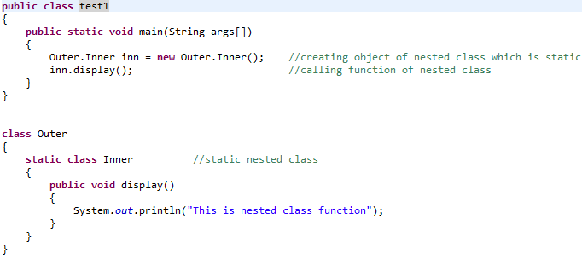
Example

Slide 26
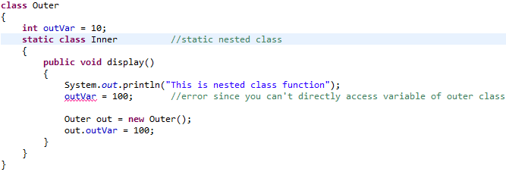
Example

Slide 27
Inner Classes
An inner class is associated with an instance of its enclosing class and has direct access to that object's methods and fields.
Because an inner class is associated with an instance, it cannot define any static members itself.
Objects that are instances of an inner class exist within an instance of the outer class.
Consider the following classes:
class OuterClass {
...
class InnerClass { ... }
}

Slide 28
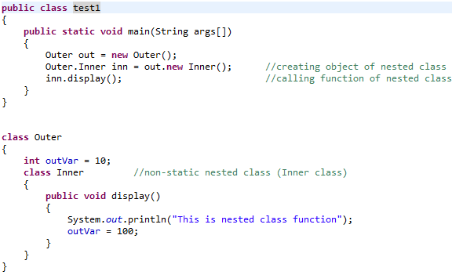
Example

Slide 29
An instance of InnerClass can exist only within an instance of OuterClass and has direct access to the methods and fields of its enclosing instance.
To instantiate an inner class, we must first instantiate the outer class. Then, create the inner object within the outer object.
Syntax:
OuterClass.InnerClass innerObject =
outerObject.new InnerClass();
Additionally, there are two special kinds of inner classes:
  local classes and
  anonymous classes (also called anonymous inner classes).

Slide 30
Local Classes
Local classes are classes that are defined in a block, which is a group of zero or more statements between balanced braces.
For example, we can define a local class in a method body, a for loop, or an if clause.
A local class has access to the members of its enclosing class.
A local class has access to local variables. However, a local class can only access local variables that are declared final.

Slide 31
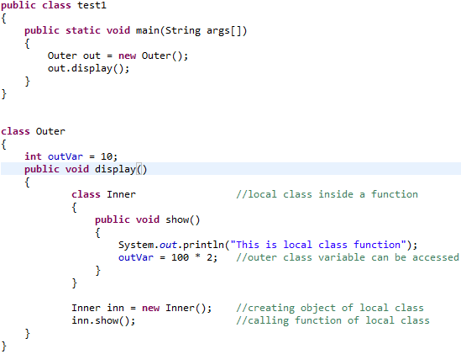
Example

Slide 32
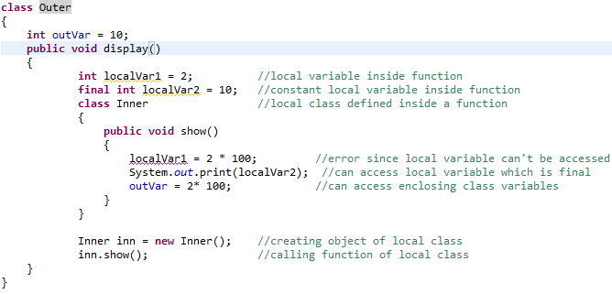
Example

Slide 33
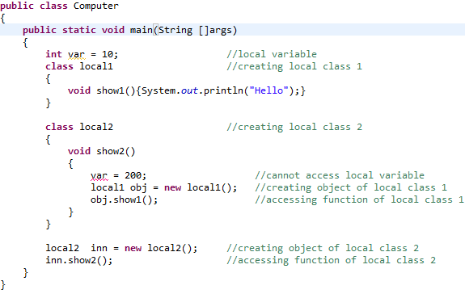
Example

Slide 34
Anonymous Classes
Anonymous classes enable us to declare and instantiate a class at the same time.
They are like local classes except that they do not have a name.
The anonymous class expression consists of the following:
1. The new operator
2. The name of an interface to implement or a class to extend.
3. Parentheses that contain the arguments to a constructor, just like a normal class instance creation expression.
4. A body, which is a class declaration body. More specifically, in the body, method declarations are allowed but statements are not.

Slide 35
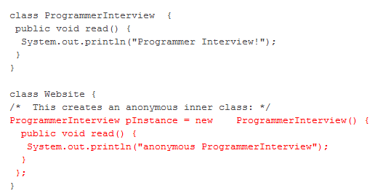
Anonymous class example

Slide 36
Anonymous inner class
An anonymous inner class is not an independent inner class.
It is a sub-class of either a class type or an anonymous implementer of the specified interface type.
So, when anonymous inner classes are in picture, polymorphism must be there. And when polymorphism is there you can only call methods from parent class reference those are defined in the reference variable type.
Java's anonymous inner classes being sub-classes or implementers do strictly adhere to the polymorphism rules.

Slide 37
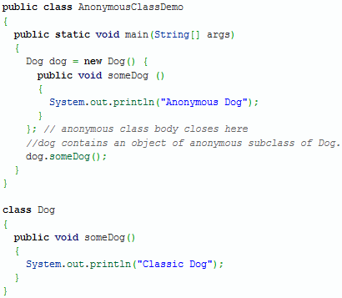
Example
the Dog reference variable “dog” refers not to an instance of Dog but to an instance of an anonymous inner subclass of Dog.
It overrides one or more methods of the super class on the fly.

Slide 38
Anonymous classes have the same access to local variables of the enclosing scope as local classes:
An anonymous class has access to the members of its enclosing class.
An anonymous class cannot access local variables in its enclosing scope that are not declared as final.
Anonymous classes also have the same restrictions as local classes with respect to their members:
We cannot declare static initializers or member interfaces in an anonymous class.
An anonymous class can have static members provided that they are constant variables.
Note that we can declare the following in anonymous classes:
Fields
Extra methods (even if they do not implement any methods of the supertype)
Local classes
we cannot declare constructors in an anonymous class.

Slide 39
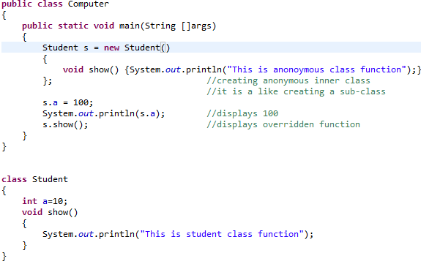
Example

Slide 40
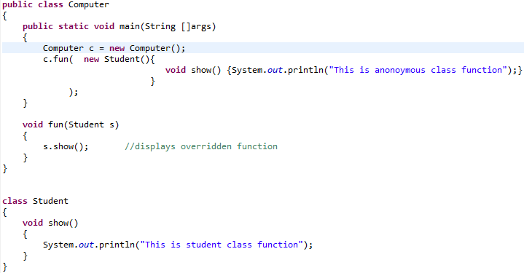
Example

Slide 41
Anonymous inner class
Remember, anonymous inner classes are inherited ones, and we always use a superclass reference variable to refer to an anonymous subclass object.
And, we can only call methods on an anonymous inner class object that are defined in the superclass.
Though, we can introduce new methods in anonymous inner class, but we cannot access them through the reference variable of superclass because superclass does not know anything about new methods or data members introduced in subclass.

Slide 42
Abstract Class
An abstract class is a class that is declared abstract.
An abstract method is a method that is declared without an implementation (without braces, and followed by a semicolon), like this:
abstract void moveTo(double deltaX, double deltaY);
Abstract class may or may not include abstract methods.
Abstract classes cannot be instantiated, but they can be subclassed.

Slide 43
If a class includes abstract methods, the class itself must be declared abstract, as in:
public abstract class GraphicObject
{ // declare fields
// declare non-abstract methods
abstract void draw();
}
When an abstract class is subclassed, the subclass usually provides implementations for all of the abstract methods in its parent class.
However, if it does not, the subclass must also be declared abstract.

Slide 44
Questions

